Slide 1
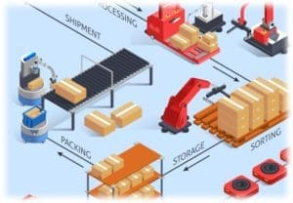
Warehouse Automation
GOVT. POLYTECHNIC SRINAGAR
Presented By
1:- Rahul Kumar (Electronics Engg. -6th Semester)
2:- Vishal Kumar(Electronics Engg.- 6th semester)
3:- Subham Bhatt( Electronics Engg.- 4th Semester)
4:- Dixit (Electronics Engg. – 6th Semester)

Slide 2
Warehouse Automation
Objective :- To create an intelligent, efficient, and scalable system
for sorting, handling, and transporting products in a warehouse with
minimal human intervention. This boosts speed, accuracy, and safety,
while reducing manual labor, errors, and costs.

Slide 3
Warehouse Automation
!
.
Problem 1: Develop a filtration system to sort products based on common criteria that can be applied universally to various types of goods.
Problem 2: Synchronize all types of conveyors and motors, and display their real-time operational data on an LCD screen.
Problem 3: Enable wireless communication between all devices in the system for seamless coordination.
Problem 4: Design an automatic pallet carrier that follows a specific pre-defined path autonomously.
Problem 5: Implement a system where the pallet automatically selects its path based on the position of the storage rack.
Problem 6: Allow the pallet to drop goods at any location along the selected path, depending on the rack position and requirement.
Problem 7: Integrate a robotic arm capable of picking up and dropping goods onto the conveyor system automatically.

Slide 4
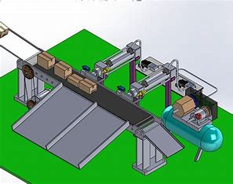
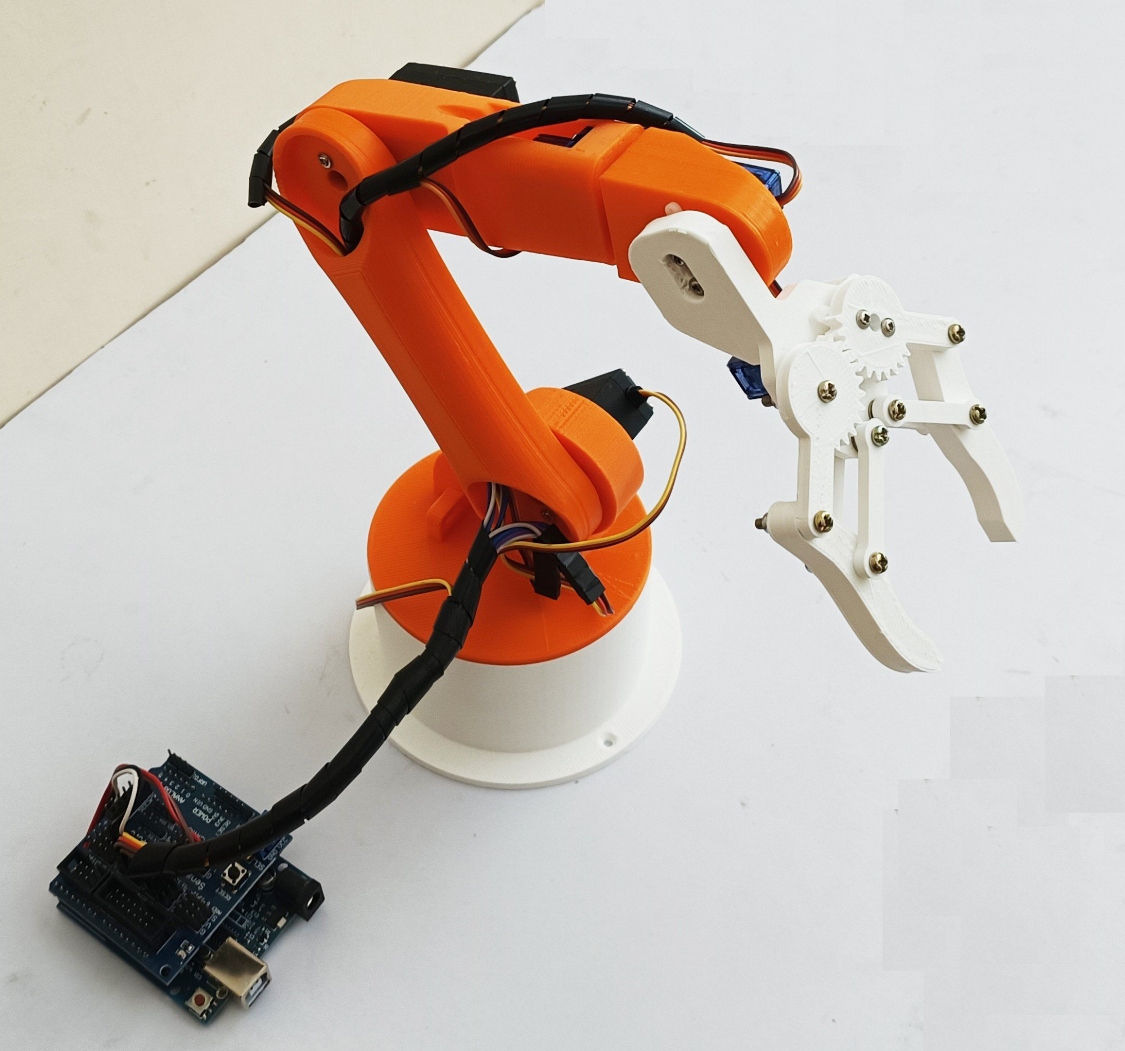
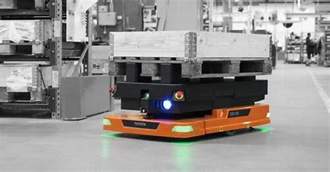
Classification of project
ROBOTIC ARM
AUTOMATICS SORTING SYSTEM
WITH REAL TIME DATA
AUTOMATIC PALLET CARRIER

Slide 5
AUTOMATICS SORTING SYSTEM WITH REAL TIME DATA
START
SEND PATH DETAIL TO TRUCK
FILTER CUBES ON THE BASES OF RED, GREEN, BLUE
COUNT FILTERED DATA AND DISPLAY IT ON LCD
IF COUNTER OF BOTH COLOR REACHED ITS MAX. VALUE , SCAN FOR TRUCK
NO
AFTER COMING BACK TRUCK WILL PROVIDE INFORMATION TO SORTING SYTEM TO START SORTING.
YES

Slide 6
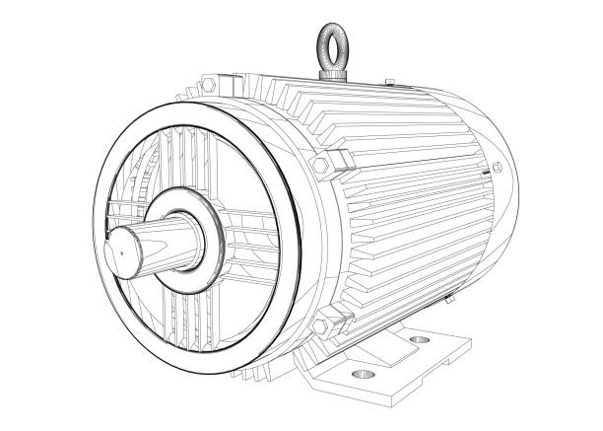
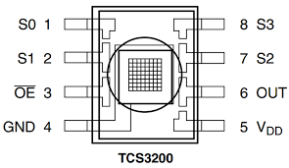
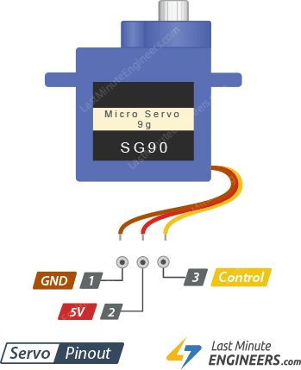
AUTOMATICS SORTING SYSTEM WITH REAL TIME DATA
12v dc gear motor-----
Voltage 12V DC ,
No-load Speed--100–500 RPM (varies with gear ratio),
Stall Torque--5–30 kg·cm (varies with gear ratio) ,
Stall Current ~2–5 A ,
No-load Current ~100–300 mA
Color Sensor (TCS230/TCS3200): Sensor Type- RGB Color Light-to-Frequency Converter
Input:- 2.7V – 5.5V DC (typically run at 5V with Arduino)
Current Consumption ~2 mA (typical);
Output Type - Square wave (frequency proportional to light intensity)
Spectral Response - 300 nm – 700 nm Filter Array - 4x4 array: Red, Green, Blue, and Clear photodiodes Output Frequency Range - 2 Hz – 500 kHz Response Time :- <100 ms (depends on lighting and processing)
servo motor(gates)--Operating Voltage--4.8V – 6.0V
Torque (4.8V) ~1.8 kg·cm
Control Signal --PWM (Pulse Width Modulation) PWM Range---500 – 2500 µs (typically 0° to 180°)
Rotation Range 0° – 180° (some can be modified for 360°) Idle Current ~10 mA
Running Current ~100–250 mA
Stall Current ~500–700 mA

Slide 7
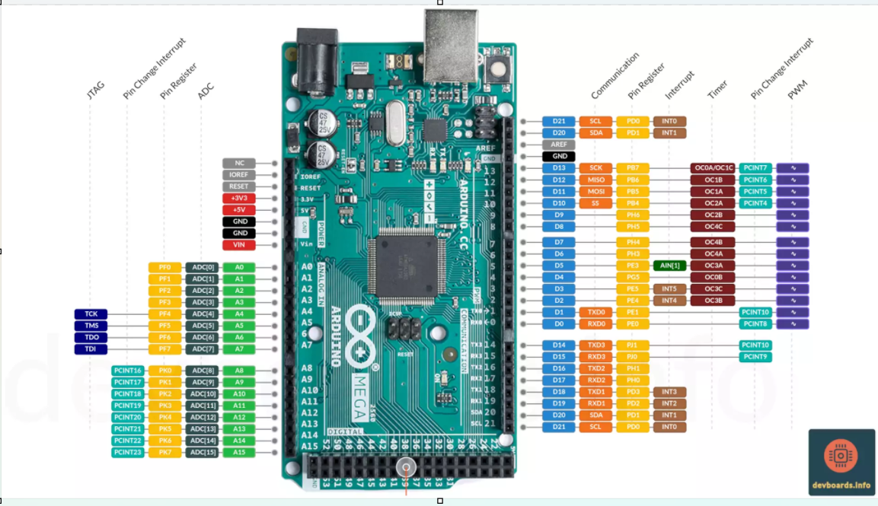
Arduino Mega 2560 -- Microcontroller –
Operating Voltage - 5V
Input Voltage (recommended) - 7–12VInput Voltage (limits) - 6–20V
Digital I/O Pins - 54 (15 provide PWM output)
Analog Input Pins – 16
PWM Pins - 15 (Pins: 2–13, 44–46)
DC Current per I/O Pin 20 mADC
Current for 3.3V Pin 50 mA
Flash Memory - 256 KB (8 KB used by bootloader)SRAM - 8 KB EEPROM - 4 KB
Clock Speed -16 MHz
UARTs (Hardware Serial) - 4 (Serial0 to Serial3)Communication - UART, SPI, I2C, USBLED_BUILTIN Pin - 13

Slide 8
AUTOMATIC PALLET CARRIER
START
SCAN FOR BLE . IF RACK BLE ( 0> SIGNAL STRENGTH >-70). DROP GREEN GOODS.
NO
DROP RED IN CENTER
YES
DROP GREEN GOODS
GOTO IN OCTAGUN PATH
FOLLOW THE PATH
START COUNTER FOR 8 SIDES OF OCTAGUN
COUNTER-1 IF COUNTER =0
GO TO INITIAL POSITION

Slide 9
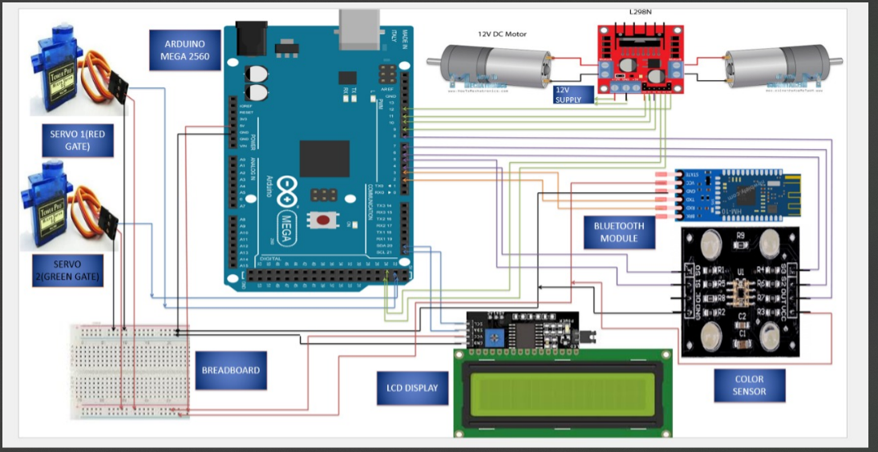
CIRCUIT DESIGN

